Slide 1
United Pride Friends
LGBT+Consortium Equity Fund Presentation
Michael Chick, Co Founder United Pride Friends

Slide 2
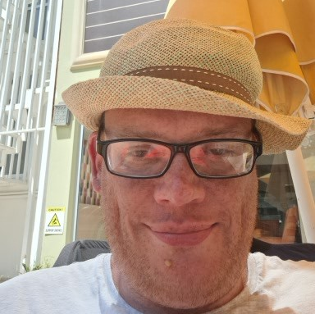
Who are we?
United Pride Friends is a group service for members of the LGBTQ+ community with Autism and Learning difficulties.
Our goal as Autistic people with learning difficulties to be recognized by society, understand what are needs are but see us in the same way as other citizens.
We want to show the world that our community can have and hold down friendships and relationships without discrimination and stereotypical views. We want people to recognize our neurodiverse world as well as out LGBTQ+ world as both are equally important to us.
Thank you so much to the LGBT+ Consortium and the Lottery Community fund for
helping us in our important aims
To expand our membership and community presence
To employ a part time worker to assist us
To participate in meaningful research
To have fun and get everyone meeting outside again
Funded by Equity Fund
Contact us
unitedpridegm@gmail.com
Facebook@unitedpridefriends
Michael Chick. Chairperson
and
co fonder of United Pride Friends

Slide 3
United Pride know themselves that as an LGBTQ+ group of people what it is like to be different.
Being Autistic as well and struggling sometimes to understand things that are not written in an easy way, United Pride knows how difficult that can be
New research from the University of Cambridge suggests that autistic individuals
are less likely to identify as heterosexual and
more likely to identify with a diverse range of sexual orientations
than non-autistic individuals. ( image copyright Cambridge University)

Slide 4
A higher percentage of autistic people identify as lesbian, gay, bisexual, transgender, or queer (LGBTQ) than the general population according to the recent research in the University of Cambridge
So at United Pride we are interested in contributing to research
and spreading that research to the important Government departments
so we can help get the right type of services to our members nationally.

Slide 5
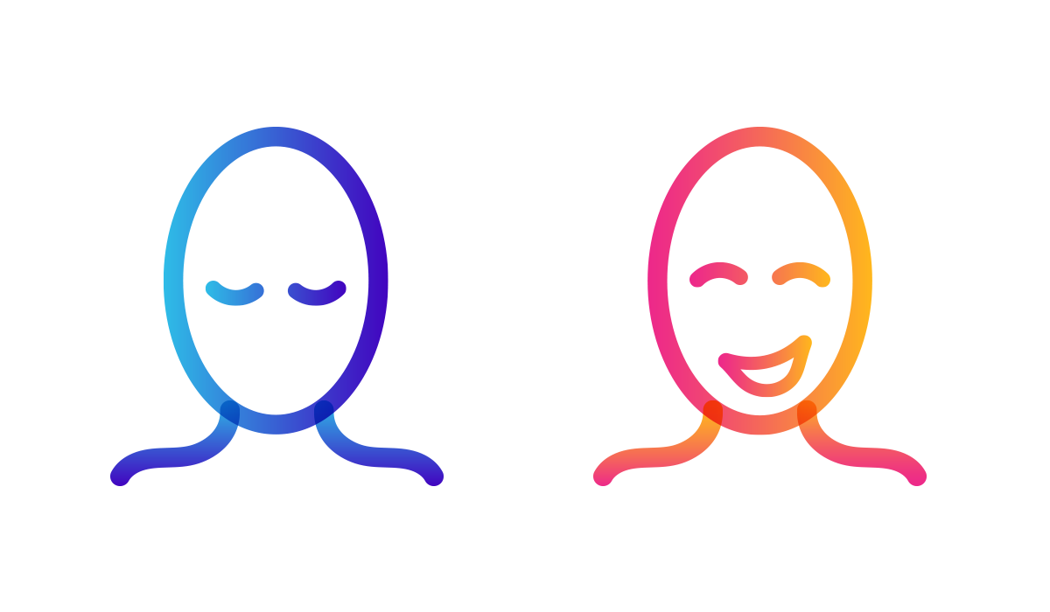
What does being Autistic mean to an individual ?
People in our group are affected by autism in many different ways.
There is no one size fits all.
But it can make life more difficult and in some situations very difficult indeed.
Because autism is a disability that is on a spectrum
Like everyone else we have our own strengths and weaknesses.
( image copyright photo National Autistic Society)

Slide 6
Being part of a community who understand what
it’s like to be a minority, can be really positive

Slide 7
.
We want LGBTQ+ people to have
a greater understanding of autism and learning difficulties,
as they already know what it is like to be
seen by society as ‘atypical.’

Slide 8
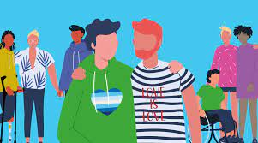
For many years it was wrongly assumed that autistic individuals
are uninterested in
sexual or romantic relationships,
but this is not the case ( recent research Cambridge University)

Slide 9
This is what a gay autistic man, Tom Moran, said about being Gay and Autistic in Gay Pride month for the National Autistic Society
“As a gay autistic man, it’s almost as if I have two identities.” I have my LGBTQ+ identity and my autistic identity. Sometimes they both merge well together, and sometimes they don’t. Often, the company will have very inclusive rhetoric and an active network when it comes to their LGBTQ+ staff. However, the rhetoric around autism and other disabilities is often lacking, or perhaps less mature. You feel accepted for one side of your identity, but the autistic part of your identity is perhaps less recognised or understood.”
United Pride say “add in our learning difficulties on top and we find we are also discriminated against in a third way. We are far less likely to be in good housing, leading independent lives, loving relationships and work.”

Slide 10
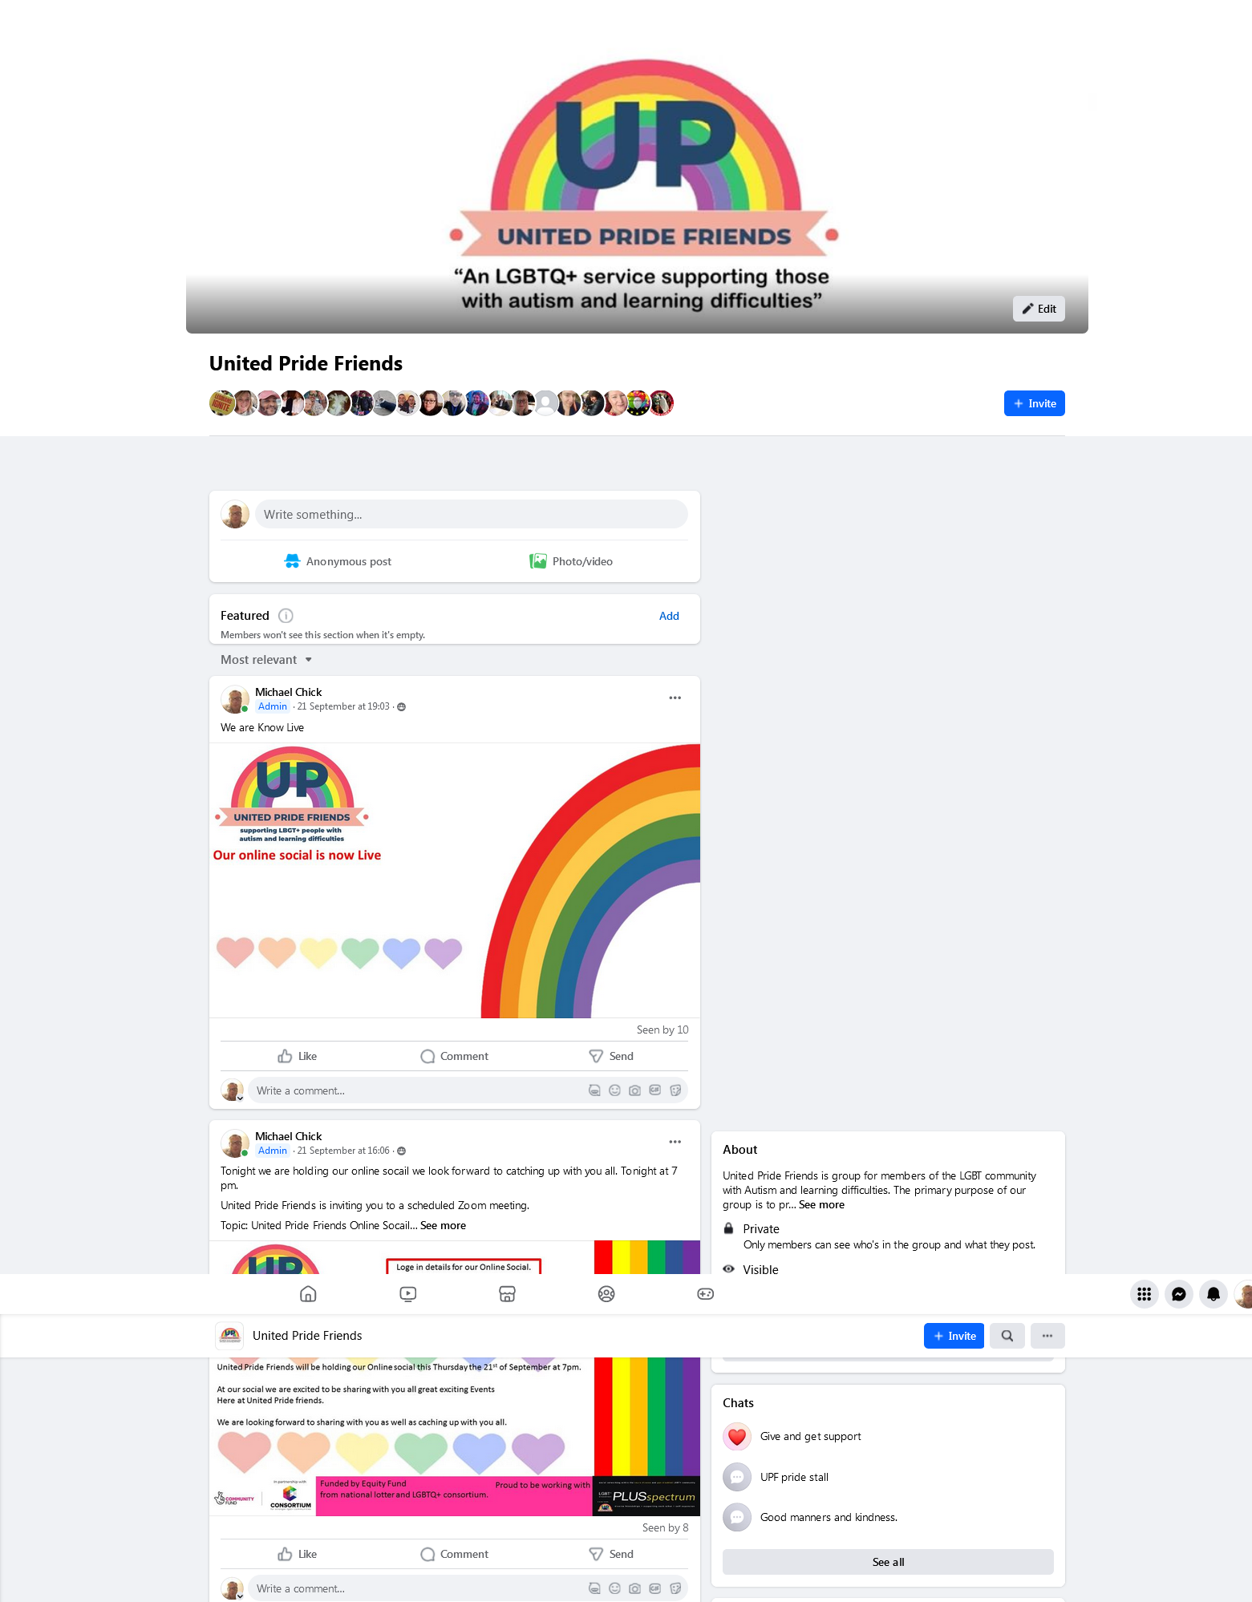
Increasing our membership.
Members Face book page
Thanks to the Community Fund project we have increased our membership by 500 per cent!
This is an incredible result and we are really proud

Slide 11
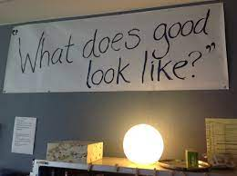
Participating in Government research
Department for Levelling up, Housing and Communities research involved United Pride in their research.
This is has resulted in a report on United Pride being incorporated into the main research of the advisory group
This involved self advocates and families of autistic people and people with learning disabilities
It was titled “what does good look like”
It explored care, housing, health, wellbeing, relationships and love.

Slide 12
Standards in Care
United Pride participated in research to improve regulatory standards
for all groups of vulnerable people
with the care quality commission, CQC
We were also member of the sub housing advisory group

Slide 13
Our on line forums
United Pride have regular well attended on line forums to discuss very important topics.
We are currently working with a professional supporter
to examine all aspects of our mental health.
We wish to expand this as a participatory research project and are looking for
sponsors to assist this vital piece of work for our group nationally.
We have started our initial research and we are engaging with the NHS Sounding Board

Slide 14
Having Fun
Having fun is really important in our lives.
Many of us suffered hugely during Covid 19
and we have found that autistic people have struggled more than others
to re engage in society.
Excerpt from recent research in the Leeds Autism Diagnostic Service, Leeds & York Partnership Foundation Trust, York, UK. below
A total of 72% respondents reported
either some or significant deterioration in mental health during the pandemic.
The issues that caused most negative impact
were uncertainty over what will happen next
and disruption of normal routine.
Respondents reported a variety of coping strategies to help them through the pandemic.

Slide 15
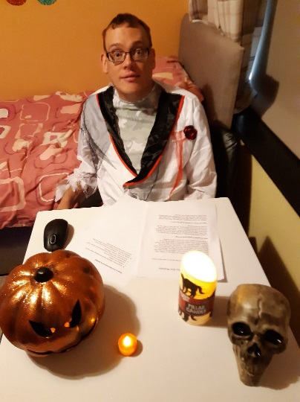
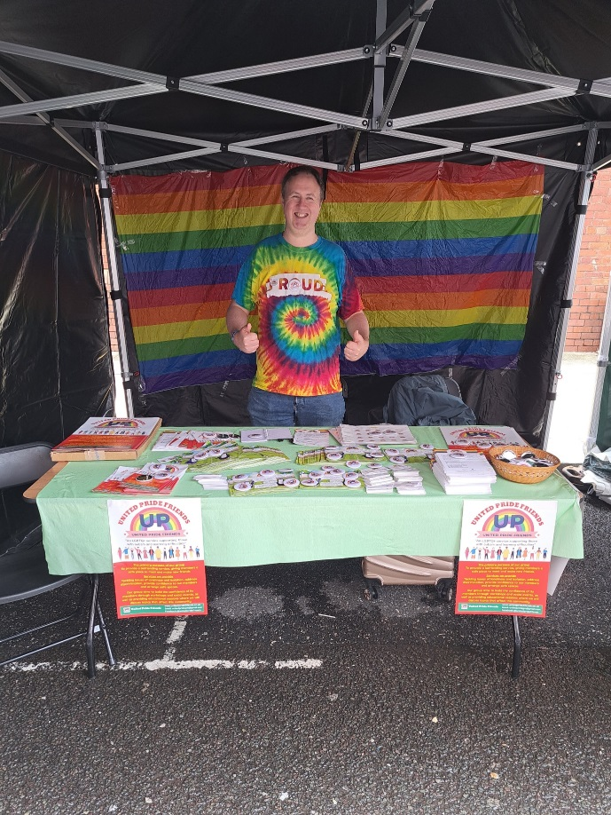
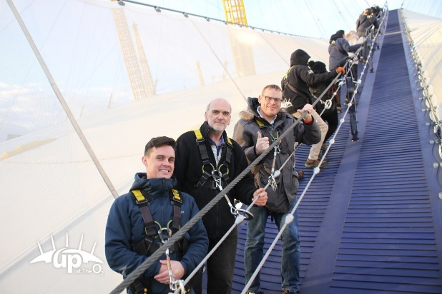
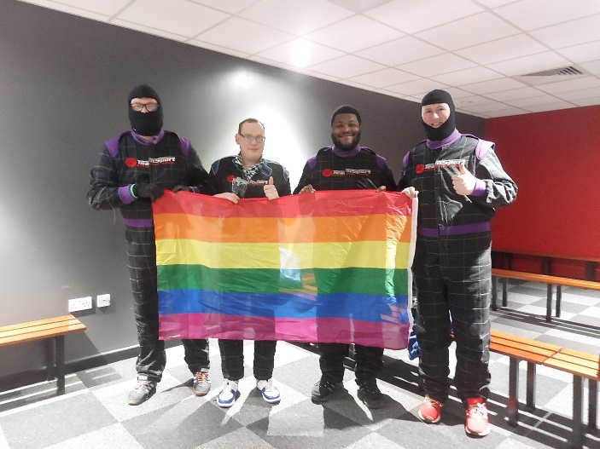
Here we are showing how we can help each other to have fun
and get back to our normal lives
United Pride Friends Halloween
Online social and Quiz
United Pride Friend fund raiser climb of the o2 Arena
United Pride Friends Go Karting Social Outing
United Pride Friends promotion stall community lane at this years Manchester Pride

Slide 16
We wish to thank everyone from the LGBT+Consortium for their fantastic help and support
and
We would not be here now without their help
and the help of the National Lottery Community Fund
Our contact details
www.unitedpridefriends.co.uk
Email unitedpridgm@gmail.com
If you are interested in supporting us in any of our future projects
Particularly our work on mental health for people who are LGBT+ with autism
and learning difficulties
please do contact us. We know people are suffering badly with their mental health
and we are keen to set up research and participate in this important subject

Slide 17
Acknowledgments
References Cambridge university research
Autism ResearchVolume 14, Issue 11 p. 2342-2354 RESEARCH ARTICLE Open Access The sexual health, orientation, and activity of autistic adolescents and adults
Elizabeth Weir, Carrie Allison, Simon Baron-Cohen First published: 18 September 2021
https://doi.org/10.1002/aur.2604
https://onlinelibrary.wiley.com/doi/10.1002/aur.2604
National Autistic Society
https://www.autism.org.uk/advice-and-guidance/stories/celebrating-pride-month-tom-moran

