Slide 1
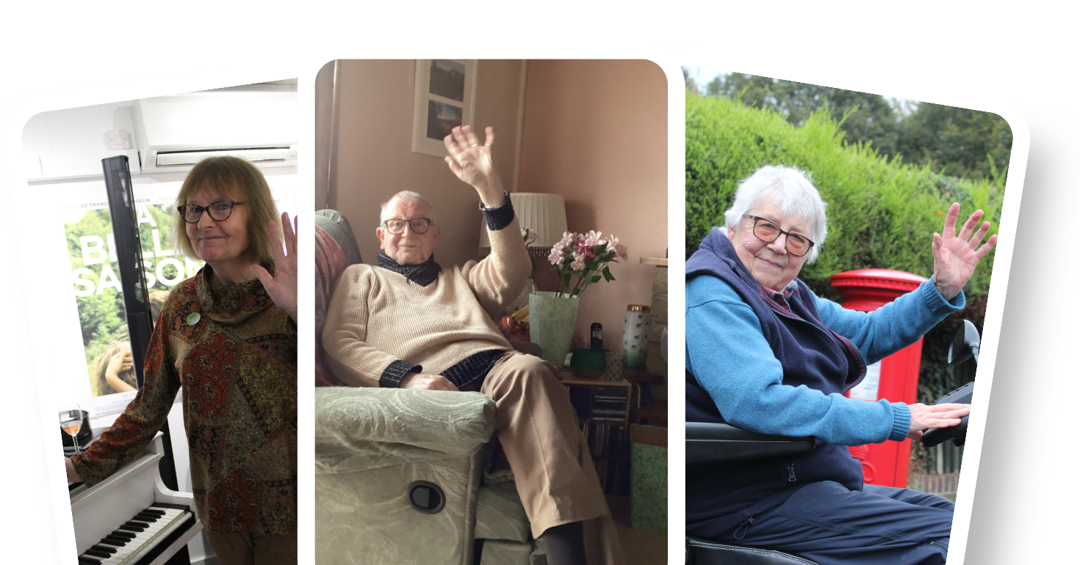
The Wave Project
Safe Ageing No Discrimination (SAND)

Slide 2
The Wave Project
“It never occurred to me that there are older LGBT+ people”
— Shropshire GP, 2018

Slide 3
The Wave Project
An exhibition of 46 photos depicting 59 LGBT+ people aged 50-100+
who live, work or play in Shropshire, Telford & Wrekin
giving us a wave and sharing what visibility means to them
displayed in Shrewsbury Museum & Art Gallery, June 2023.
Here is a sample!

Slide 4
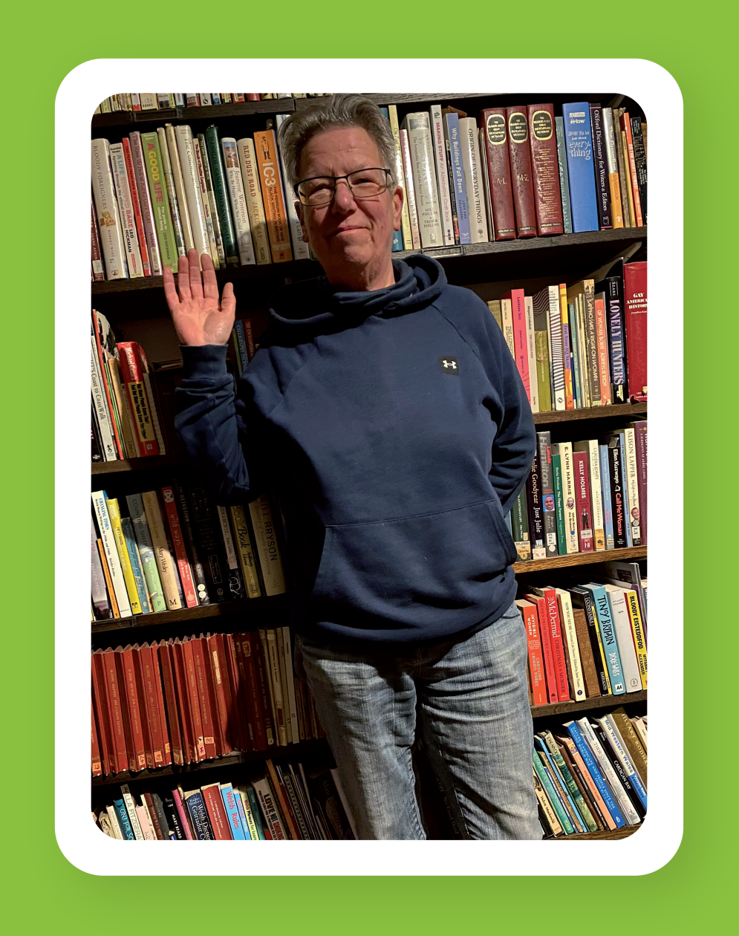
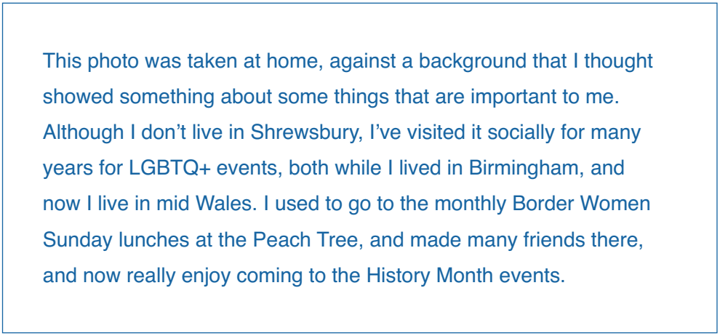
The Wave Project

Slide 5
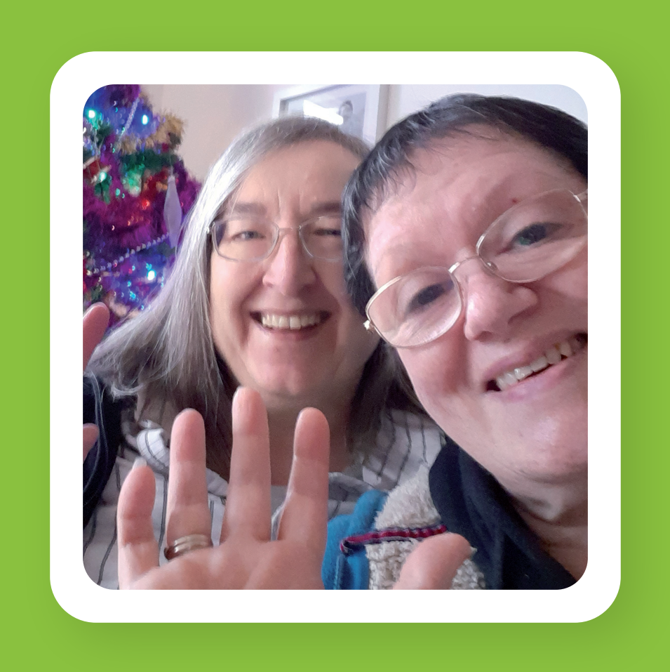
The Wave Project

Slide 6
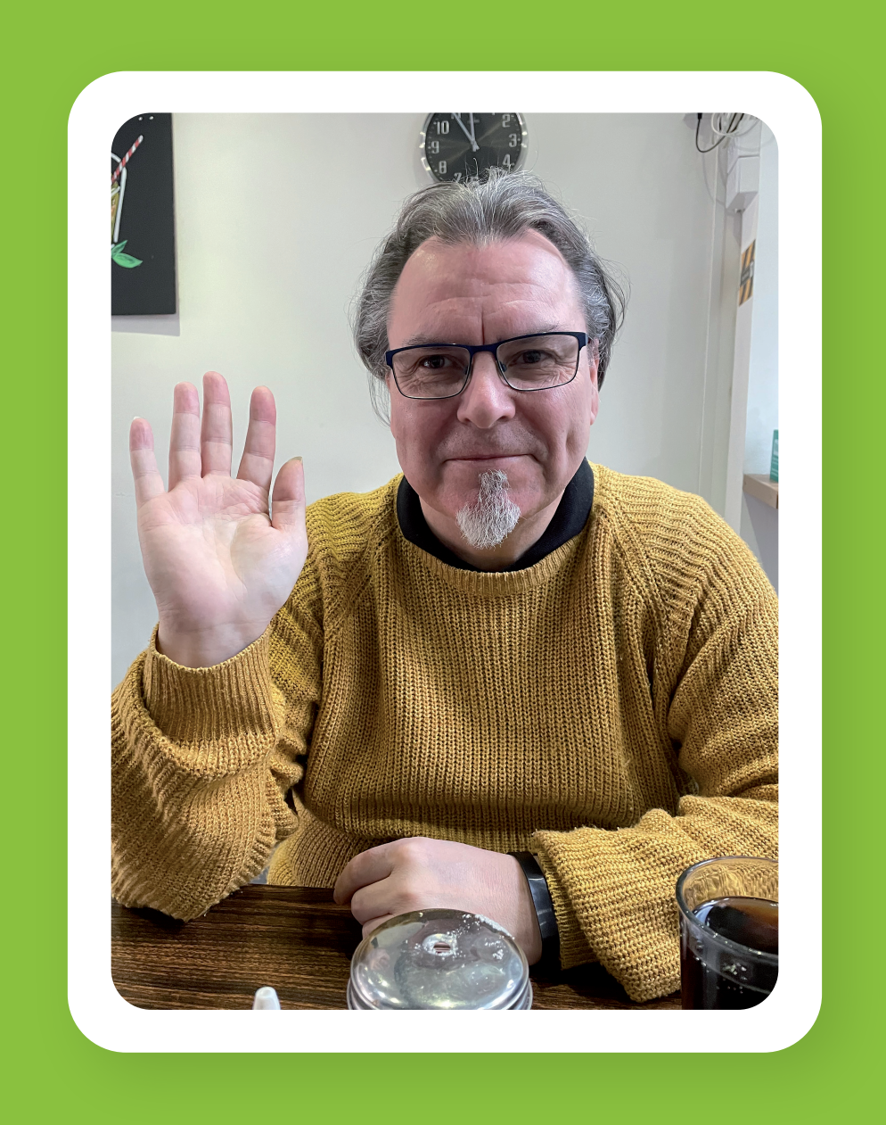
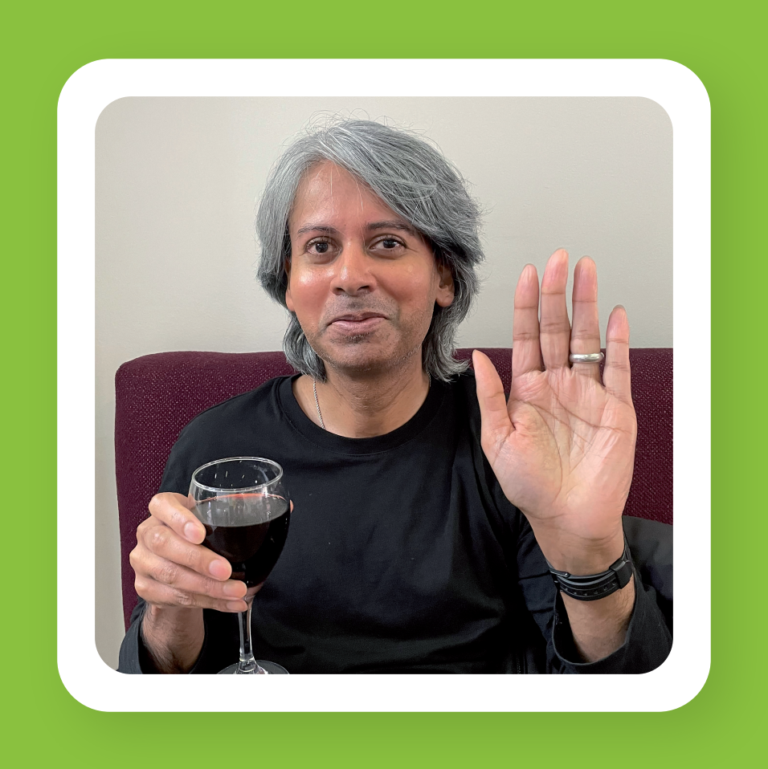
The Wave Project

Slide 7
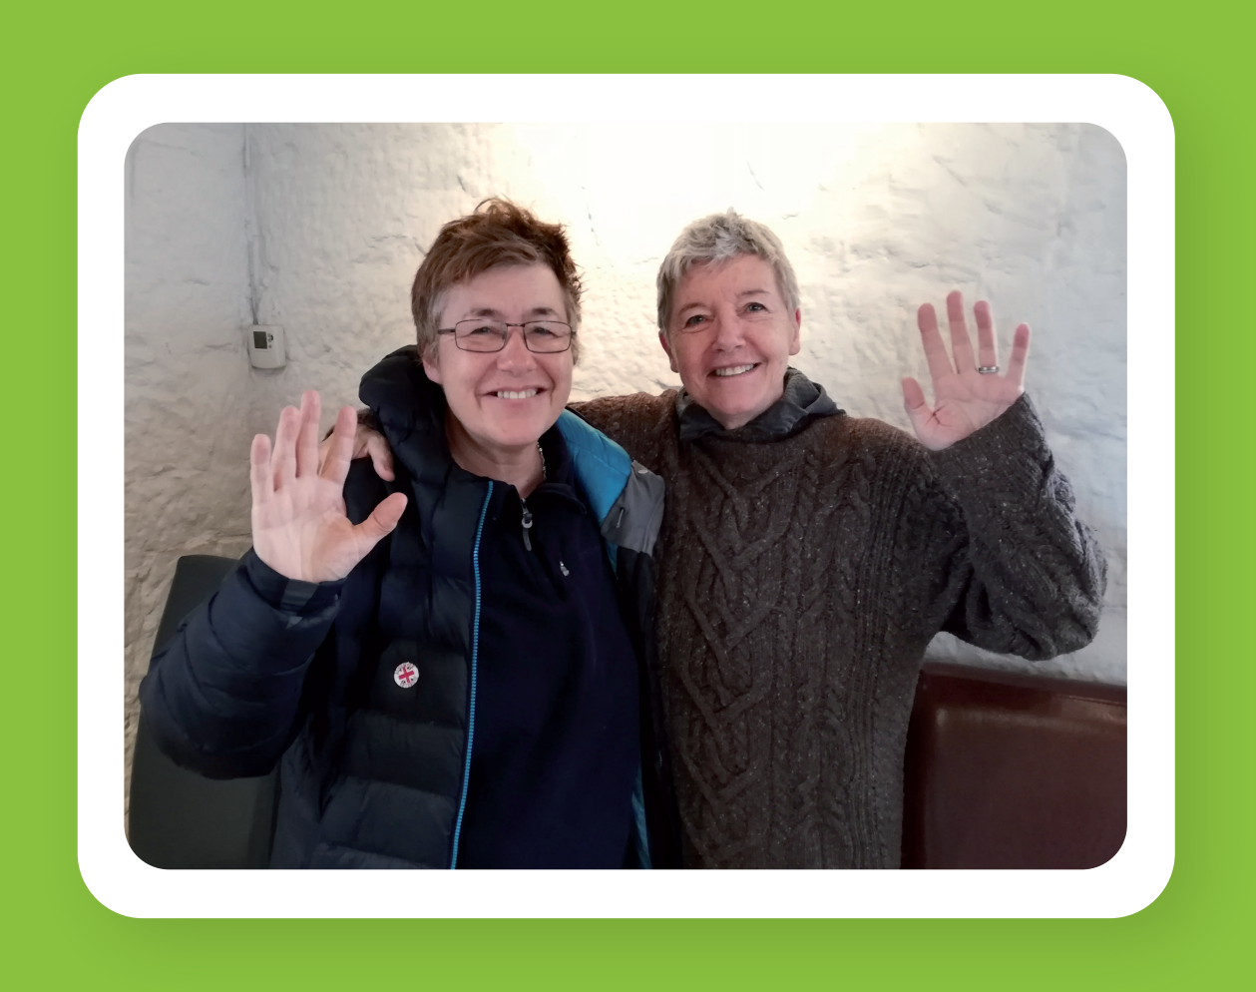
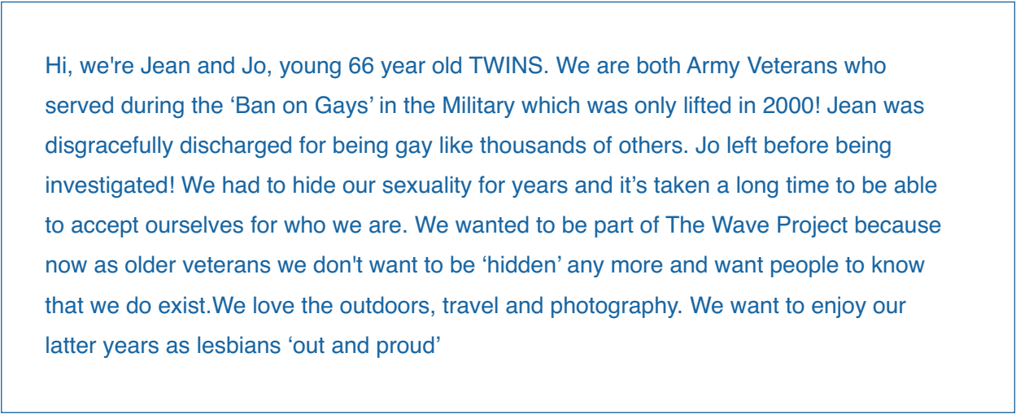
The Wave Project

Slide 8
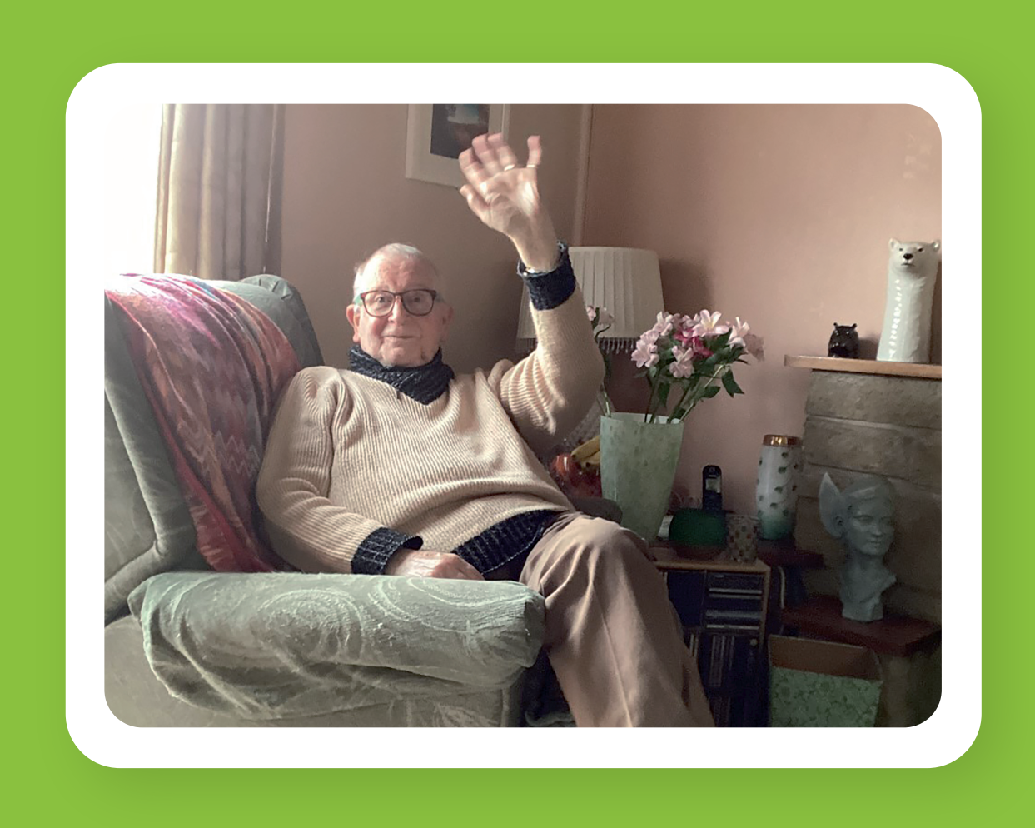
The Wave Project

Slide 9
The Wave Project

Slide 10
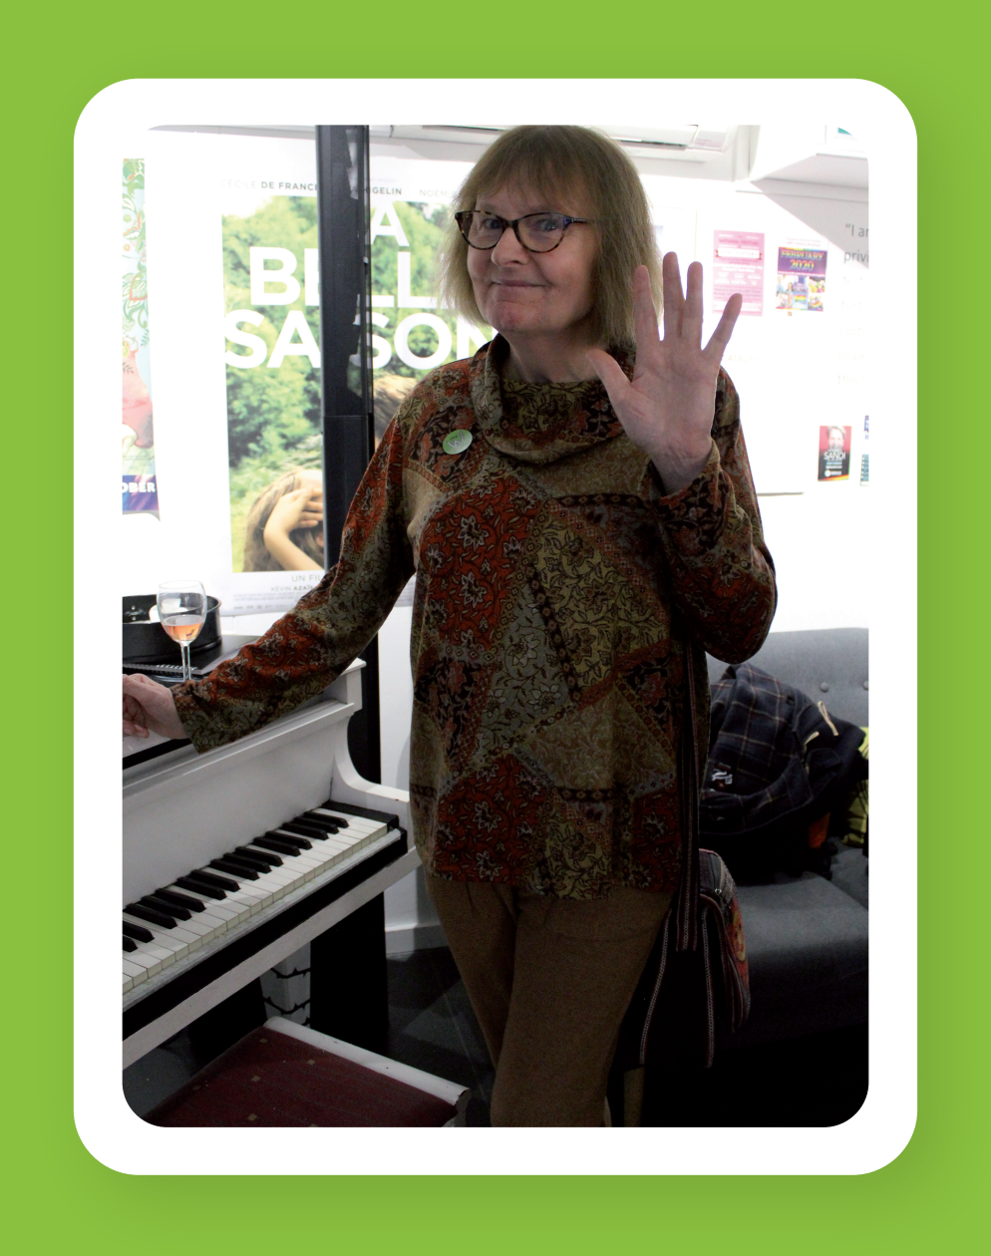
The Wave Project

Slide 11
The Wave Project

Slide 12
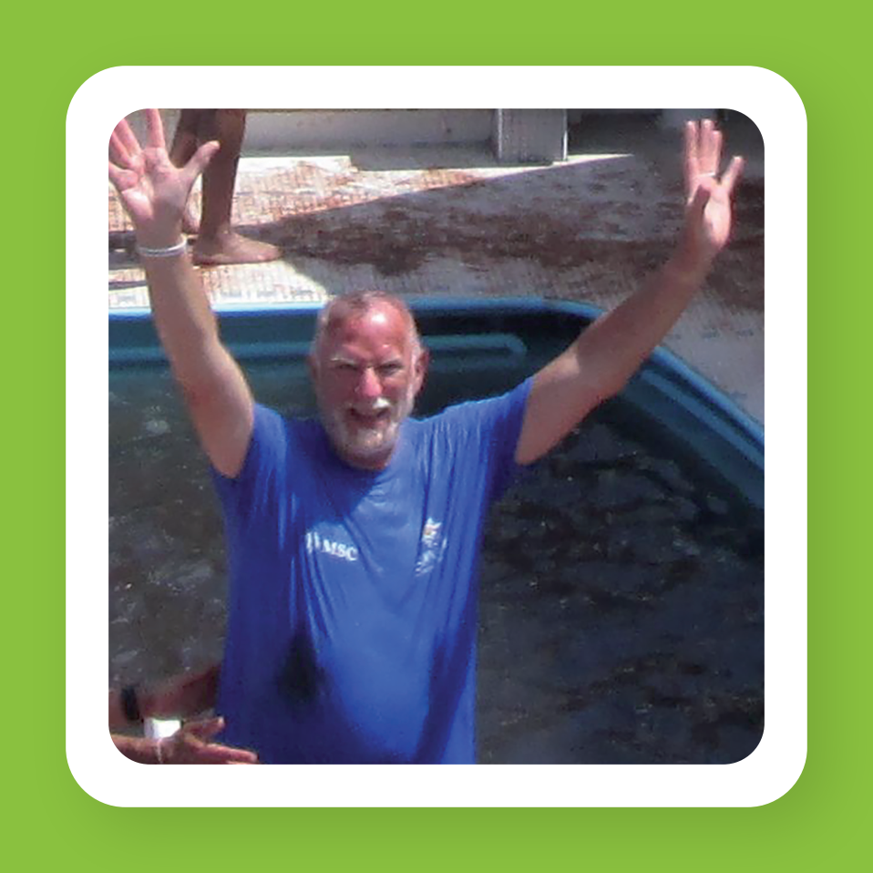
The Wave Project

Slide 13
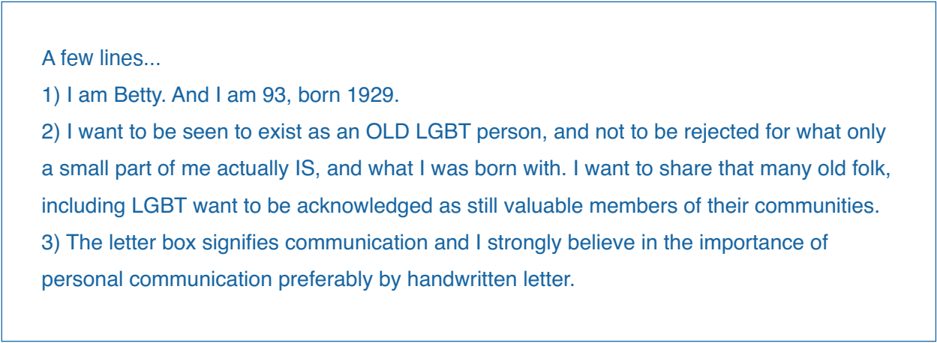
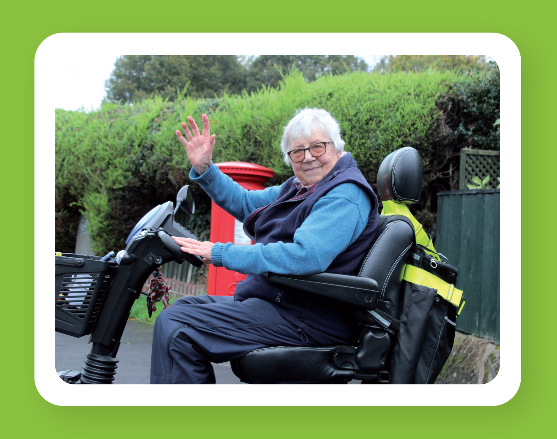
The Wave Project

Slide 14
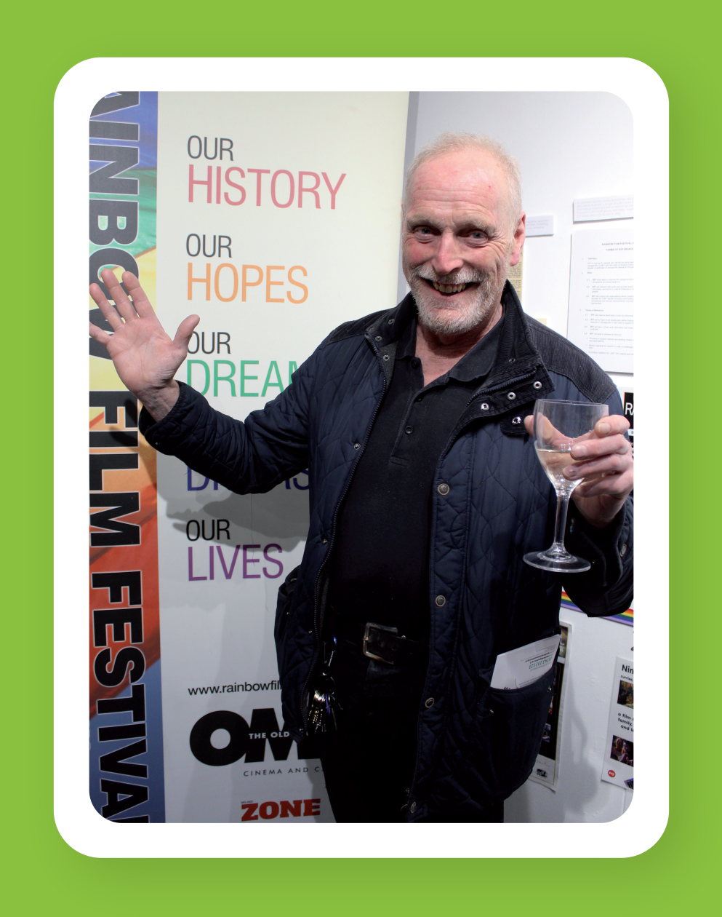
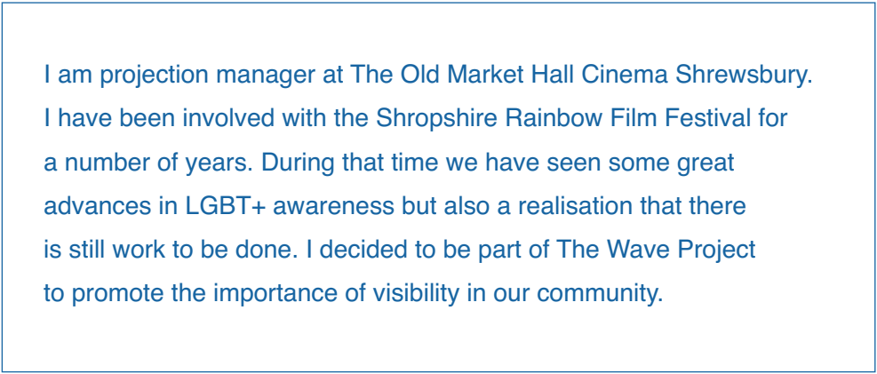
The Wave Project

Slide 15
The Wave Project
Find out more about SAND:
www.lgbtsand.com
info@lgbtsand.com
@lgbtsand

