Slide 2
Workshop Outline
Organisational Sustainability...?
Developing your organisations sustainability
Using Theory of Change developing sustainability

Slide 3
Ice breaker....
Your Name
Your Organisation
Tell us 1 thing (yes, just 1) that your organisation does brilliantly

Slide 4
Sustainability Challenges
Many small charities must work very hard to bring small amounts of money in
LGBT+ Charities 0.04% of overall funding
Culture of grant reliance (project based)
Limited capacity to invest in new income streams and sources and address wider challenges

Slide 5
Sustainability
What does a
sustainable organisation
look like to you?

Slide 6
Fit for Funding, Fit for Purpose
Reflect on and review your current structure and governance, is it the most appropriate and effective it can be?
Structure
Governing Document
Policies
Procedures
Plan, objectives and vision

Slide 7
Know your Core Work
What are the key activities and people that make up your core work?
Are you as focussed on it as you should be?
Is it sustainable?
Know your core costs

Slide 8
Know your strengths
Including:
resources and assets
team skills, knowledge and relationships
trustees skills, relationships and influence
your ‘sellable’ offer

Slide 9
Exercise: Where are you now?
{
{
{
{
{
{
We are not sustainable and it is not one of our priorities
We have a plan but find it hard to find the capacity to work on it!
Our core work is sustainable but the organisation as a whole is not
We are not sustainable but its on our radar and we know we need a plan
We have a plan and we are working on the sustainability of our organisation
We are sustainable. We have multiple, sustainable sources of income

Slide 10
Planning for sustainability
Compare
Where your organisation is now
What does sustainability look like
What changes do you need to make for your organisation to get from A to B?

Slide 11
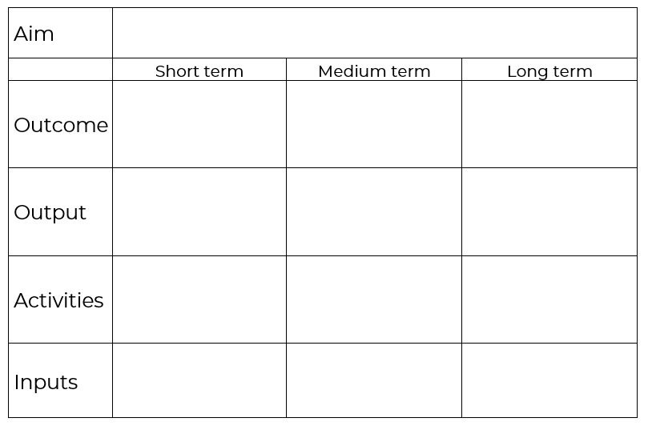
Theory of Change
Consortiums core work is sustainable by the end of 2022
What you set out to do
Membership programme is self sustainable
The changes your work makes or that occur as a result of your work
External
and
Internal
Influences?
Fee structure & menu of add on services
Publicity drive
The tangible, immediate things that come from your activities
Consult
Review
Plan
The practical things you do
Engagement Team capacity (£)
The resources needed

Slide 12
Sustainability
Give yourself time to ‘think outside the box’ and be entrepreneurial; face up to tough decisions and change and make sure you keep abreast of new opportunities. Look after yourself and your staff to minimize stress, and don’t be afraid of saying no to new services, particularly if you can’t afford to run them.
The Kings Fund

Slide 13
Next Steps
Develop or review your ToC
Utilise exiting team skills and seek support where you need
Use the ToC to develop a timeline of actions

Slide 14
Support and information
Consortium Members can access a range of training and resources through their Members Dashboard
Non Members can access a range of webinars

