Slide 1



LGBT+ Group Conference:
Evaluating your own work
Saturday 9th November 2019
Nathan Hudson-Sharp
Senior Social Researcher, National Institute of Economic and Social Research (NIESR)
@nhudson_sharp
@NIESRorg
@LGBTConsortium
#ESRCFestival
Notes:
Purpose of this workshop is to give you the opportunity to start thinking about evaluation, why it might be important for your organisation / project and the best ways to go about it
Lots of information and support out there for thinking about evaluation – including from a Voluntary and Community Services perspectives (particularly from NCVO – drawn on some of that here so familiar with the same stuff).
Important to discuss from a LGBT+ perspective, which I don’t think is readily available.
Usually 1-2 day course – we’ve got an hour so it’s going to be a bit of a whistle stop tour.
Introduce what evaluation is
Discuss the different forms it can take; what the process can look like from your organisation
Some of the challenges for the LGBT+ sector, particularly around resourcing and data.
Not a lecture – as interactive as we can. Interrupt me and discuss throughout. I’d like to learn from you guys as well.
Name, pronouns, organisation/project your represent, and any experience with evaluation so far.
Nathan, pronouns are he/him, I work for the National Institute of Economic Social and Research as Senior Social Researcher, where I undertaken research and evaluations – evaluations vary from programme evaluations for organisations like the Joseph Rowntree Foundation (MIS), Equality and Human Rights Commission (IBF), to school interventions (healthy minds; formative assessment)

Slide 2
What is evaluation?
Evaluation is what an organisation does to plan, understand, communicate and improve its impact.
Self evaluation is when an organisation uses its internal expertise to carry out its own evaluation.
Why should we evaluate our own work?
Develop your strategy and organisational plans
Make your work more effective
Report to funders and attract future funding
Improve your communications
Motivate staff and volunteers
Notes:
Evaluation is what an organisation does to plan, understand, communicate and improve its impact.
From my point of view conducting an evaluation is about taking the time to step back and taking stock, think about what you’ve doing, and thinking about how you might improve things on various levels which we’ll go through in a minute
Self evaluation is when an organisation uses its internal expertise to carry out its own evaluation, as opposed to drafting someone external in like myself or NIESR
Pros and Cons of self evaluation
CON: You need be able to dedicate time and resources
CON: It requires some preparation and serious thinking. And it’s a commitment. Not a one-off activity or an event, but rather an practice that you undertake over an extended period of time, depending on your work
CON: Legitimacy of independent evaluation – the reason why people pay us is because to self-evaluate is kind of like marking your own homework. For those most part, that’s absolutely fine Depends on what purpose of your evaluation is? For yourself? Funders? How honest can and will stakeholders be?
Afraid to say – issue in people politicising your work. LGB but particularly trans and non-binary service. Hold up to scrunity, particularly if public money, and particularly if evaluation is going to be public knowledge.
PRO: It will save you so much money - £££. Organisations pay a lot to have programmes evaluated externally.
PRO: You know your organisation. Take weeks to get to grips with the details of a project or organisation
PRO: There is a lot of support and resources out there to get you on your way
Before I got into evaluations, I was actually quite cynical – I thought that organisations and projects would have some idea about their impact and progress so it felt a little unnecessaary. However since I got into research, learnt from others and realised it’s not a on-off activity but more an embedded practice, it started to make a lot of sense.
There’s a few reasons why I think evaluations are important:
Develop your strategy and organisational plans
Identifying the difference you want to make can help you focus your organisation’s strategy and plan how to use your resources efficiently.
Make your work more effective
Through evaluation, you can identify where your work is most effective, and where you might change or develop. This can help you improve services and programmes so you can make a bigger difference for your beneficiaries.
Report to funders and attract further funding
Those funding, commissioning or investing in voluntary organisations increasingly ask about the difference organisations have made – not just what they’ve delivered. Collecting evidence of your outcomes and impact can also help build a case to attract repeat or new funding.
Improve your communications
Evaluation findings can help you communicate with your organisation’s key audiences. You could share your findings to engage current or potential donors, or to increase public understanding of what you achieve. You might also be able to use your data for lobbying or campaigning.
Motivate staff and volunteers
Seeing evidence of what their work has achieved can boost staff and volunteer morale, generating a sense of shared purpose – JRF EXAMPLE OF MOTIVATING STAFF

Slide 3
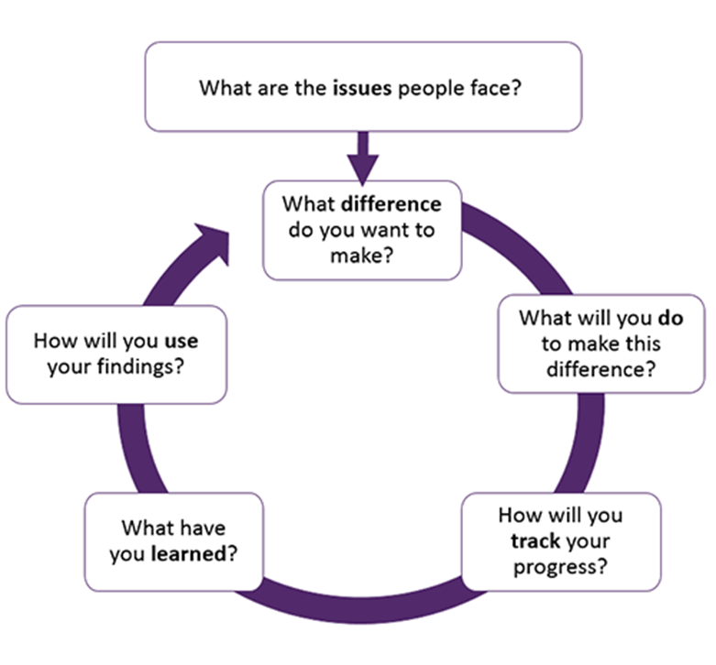
The Evaluation Process
What is the purpose of your evaluation? What do you want your evaluation to demonstrate?
Who are you evaluating for? Is it for your funders, the community, or your organisation?
What are you going to evaluate? Which elements of the project do you intend to look at?
How are you going to evaluate? What methods are you going to use to carry out your evaluation? You should use a range, and collect both quantitative and qualitative data.
How will you collect the data you need? Is the data available? If you need data from across the project, have you set up monitoring to capture it?
What will you do with the data you collect?
https://knowhow.ncvo.org.uk/organisation/impact/about-impact-and-evaluation/the-evaluation-process
Notes:
So what does evaluation actually look like?
This diagram is from NCVO. You can access this and a lot of their other resources on their website which I’ve linked below. I’ve stolen it because I think it’s important that if you want to you can go get extra support and information if you need so I’ve tried to base this on resources that are at your fingertips, for free.
As you’ll see evaluation comprises of about 6 stages.
**Read circle** . We’re going to be looking at the first 3-4 stages today. Thinking about defining impact, working out outcomes and data and measurement
More generally, on the side here I’ve left some questions which I think are fundamental when starting to think about your evaluation. I’ll quickly go through one by one – shout at me if there’s anything that isn’t clear
That core question what is the purpose of your evaluation is really important, as well making sure all your staff, volunteers and stakeholders are on baord. Being clear about what the objectives are before you start any type of evaluation is really fundamental. I’ve been part of evaluations that have tried to shift the goalposts mid way through and it doesn’t work
Thinking about who you’re evaluation is for is really important. There’s a big difference as to whether it’s for internal purposes, external purposes as in with your stakeholders, or fully external (combination EHRC example)
Doesn’t have to be whole organisation’s work or whole project. Components. Are you interested the impact you’re having. Whether you’re reaching the right people? Whether you’re wasting money or time somewhere down the line
The difference between quantitative and qualitative data is quite important. By qualitative we’re often on about non-numerical data. Quantitative on the other hand can be counted, measured and expressed in numbers. The difference is really important in the LGBT+ sector – which I’ll go into in a little bit.
Working out how you’re going to capture your data is really important. It’s got to be realistic, it’s got to be as easy as possible, it’s got to be useful. I’ll go through some of the methods in a bit that will hopeffully give you some inspiration.
Are you going to write a report? Is it going to be useful for funding bids. Is it gonna be publicly avaliable?

Slide 4
Types of Evaluation:
Process Evaluation
How is the program being implemented?
Has the programme been implemented correctly?
Are participants being reached?
How satisfied are participants?
Outcome Evaluation (or impact evaluation)
How well did the programme work?
Did the programme produce or contribute to the intended outcomes?
Where there unintended outcomes (positive and negative)
To what extent can change be attributed to the programme?
Economic Evaluation (cost-benefit analysis)
How much did the programme cost?
Has the programme been cost effective?
Has the programme been the best use of resources?
Notes:
There are essentially three types of evaluation. You can choose to do one, two or all of these – depending on what you think is most useful.
Process evaluation – [3 main questions] – Process evaluautons most explore how things work. this is what I tend to do cause I’m predomiantely a qualitative research and you can usually best answer these questions with qualitative data.
Outcome evaluation. Working out whether your programme has achieve what you want it to achieve. Whether the programme has been effective. This is often on more quantitative measures where you want clear, attributal evidence of impact from your programme or work. That being said it doesn’t always have to be quantative or numeric, largely depends on what your project or evaluation is. What I will say when you want to prove impact, numbers are easier for funders etc. to digest instead of words.
Finally, economic evaluation. This is gonna be really important for organisations that want repeat funding. Proving where the money went and how you’ve made the most of it is really important. Being able to attribute it to specific elements of your work is also important so you can make informed decisions about better spending (EHRC cost issues)
*** any questions***? What kind of evaluation might be most useful for you?

Slide 5
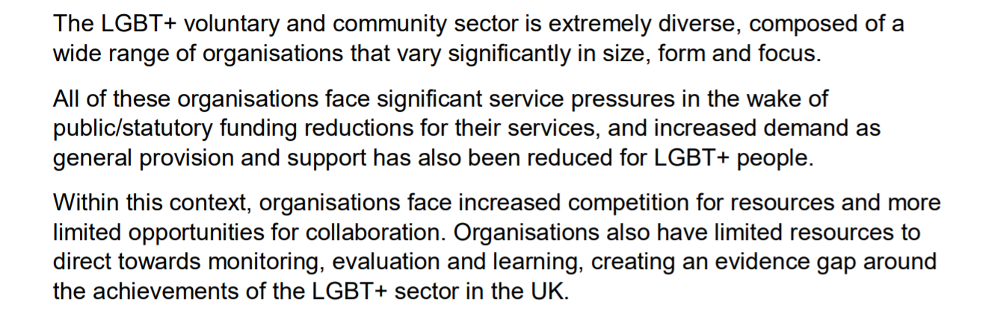
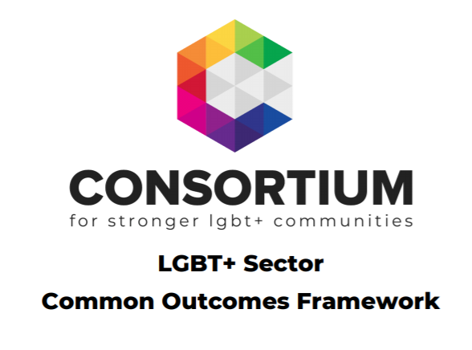
Challenges for the LGBT+ Sector: Resourcing
Notes:
Thinking about the specific challenges of undertaking evaluation for you operating in LGBT+ voluntary and community sector is really important. I pulled this from Consortium’s Common Outcomes Framework cause I thought it summarised it best, and they and you are the experts on this
As it says and as you’ll know , the LGBT+ voluntary and community sector is extremely diverse, composed of a wide range of organisations that vary significantly in size, form and focus. I think this makes giving and getting advice and support quite challenging. A lot of the support you need is likely going to have to be bespoke for you to get the best out of it.
All of these organisations face significant service pressures in the wake of public/statutory funding reductions for their services, and increased demand as general provision and support has also been reduced for LGBT+ people. Within this context, organisations face increased competition for resources and more limited opportunities for collaboration. Organisations also have limited resources to direct towards monitoring, evaluation and learning, creating an evidence gap around the achievements of the LGBT+ sector in the UK
I think, and correct me if I’m wrong, that voluntary and community sector (VCSE) organisations are frequently asked by funders to demonstrate their value budgets or from their own data and resource. Even where VCSE organisations are not asked to formally evaluate by funders, they still want to understand what impact they make.
**anyone speak to these issues**?

Slide 6
Challenges for the LGBT+ Sector: Data*
Most Evidence
Least Evidence
Disaggregation
Evidence Gaps
Intersectionality
Data Quality
Access
* Rough, non-comprehensive summary
Notes:
Data is a really big issue for the LGBT+ sector, and I’m a big LGBT+ data nerd so I’m going to rant for a bit.
The quantity and quality of data on LGBT+ people in the UK is pretty shocking. When I did the LGBT evidence review for the Government Equalities Office I was constantly explaining and writing that there is no data on this, crap data on that, and that has really serious implications for the you in the voluntary and community sector because you’re working from scratch.
If you want to make a funding bid to start up or extend a service or a project very rarely are you going to be able to just pull some data that says “there is a demand for this service”. That means you’re immediately at a disadvantage than in other areas because you’ve got nothing to hinge your ideas on to convince funders, partners etc. so you’ll left to create your business case. This is why self-evaluation is so important no one is doing the work for you, so if you want to make case for something, you need to collect that evidence to form really strong business case for repeat or new funding, for example.
**Example – I was pitching a programme to do some work that would help promote trans-friendly business practices with employers with london. All went really well until at the end of the meeting I got asked to provide some data that said how many unemployed trans people there are in London who might be supported by this service** I understand why – trustees of that organisation needed some sense as to how many people the money they’re parting with is gonna help – the problem is the data is just not avaliable. What I’m gonna have to do is scour is either write a funding bid that doesn’t meet those requirements, or I’m gonna have to do some data collection myself.
I’ve pulled together this very quick diagram to demonstrate the composition of avaliable data. It’s not just indicative, but it show key issues. Just to explain (explain the diagram)
Disaggregation
Evidence gaps
Intersectionality
Data quality (Stonewall). Preference for comparative quantitative data.
Access – peer review

Slide 7
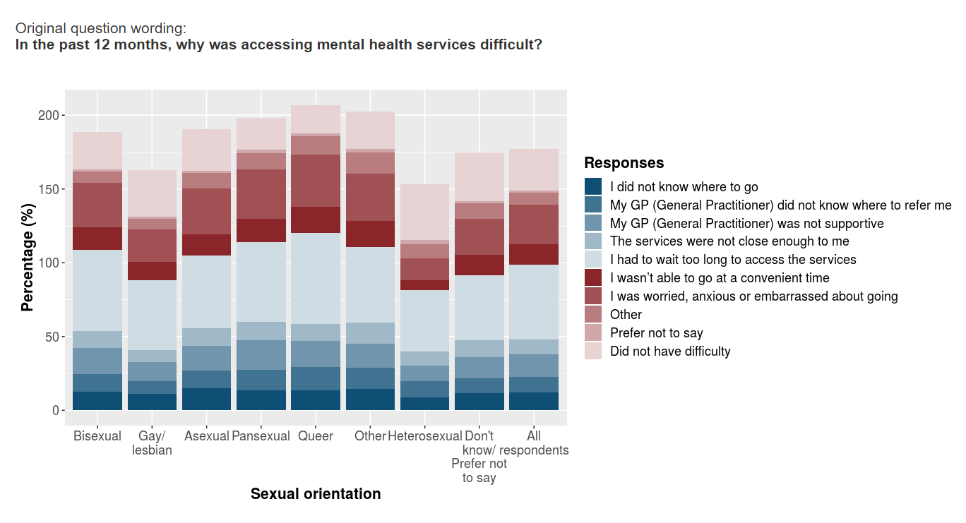
Challenges for the LGBT+ Sector: Data
National LGBT Survey 2017: Data Viewer
https://www.gov.uk/government/publications/national-lgbt-survey-data-viewer
Notes:
There has recently been a little bit of hope for data. The GEO National LGBT Survey data viewer does give us more opportunity to develop business cases.
**Ask if used it?**
**not ideal – issues with disaggreation. Definition of trans / NB were a little patchy. It is quite general so it may not be super relevant to some of the issues you want to addressing and dealing with.
if anything it helped promote internally the issues with data in the UK so there’s a bit more of an understanding.
**ANY QUESTIONS?*

Slide 8
As a group, start thinking about impact and outcomes
Who is my project/work for?
What are the needs, issues, challenges that they face?
How does my project/work intend to address these?
Impact is the effects of a project or organisation’s work. This can include effects on people who are direct users, effects on those who are not direct users, or effects on a wider field like government policy.
Intermediate
Long-term
Short Term
Might include changes in behaviour or changes in how services are delivered. Expect these between several months or a year after end of activity or project
Might include changes in policies or organisational structures. Expect these a year or several years after the end of activity or project
These can be directly attributed to your work. Might include changes in awareness, knowledge, attitudes. Expect these at the end of activity or project
http://www.lgbtconsortium.org.uk/LGBTOutcomes
Notes:
So, that’s some of the challenges that we’re faced with when thinking about why and how we’re gonna do evaluations.
**ANY QUESTIONS?** anything that isn’t clear; not relevant? Relevant?
OK, so let’s shift gear and get a little bit more practical. What I want to do as groups now is start thinking about impact and outcomes to form the basis of our evaluation
FIRST TASK: as group I want you to pick one organisation or project amongst you and answer these three questions.
**DISCUSS**
Now, we’ve done that let’s try and translate that into the language and format of evaluation…

Slide 9
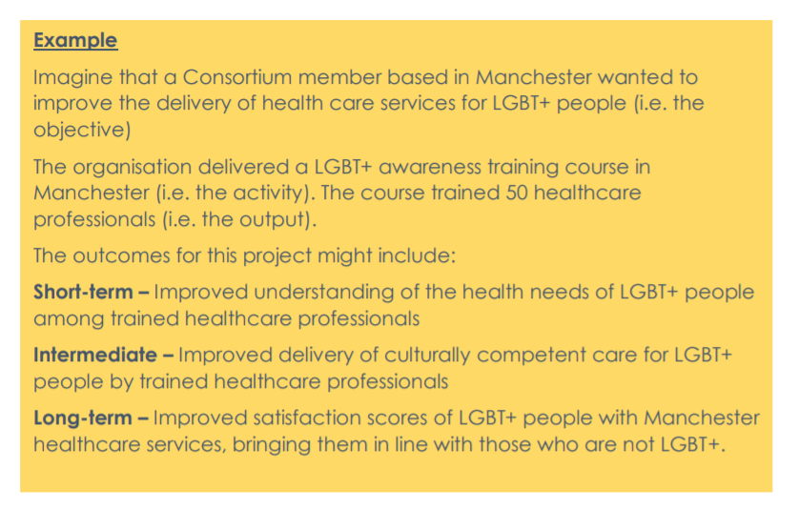
Intermediate
Long-term
Short Term
Might include changes in behaviour or changes in how services are delivered. Expect these between several months or a year after end of activity or project
Might include changes in policies or organisational structures. Expect these a year or several years after the end of activity or project
These can be directly attributed to your work. Might include changes in awareness, knowledge, attitudes. Expect these at the end of activity or project
http://www.lgbtconsortium.org.uk/LGBTOutcomes
Notes:
When we think about evaluation, there’s three stages of impact or outcome that we usually want to see
Short Term
Intermediate
Long-term
Now, using this example as guide I want you to try and translate what you’ve done into one short-term outcome, one intermediate outcome, and one long-term outcome.
Then we’re going to discuss.
[DISCUSS as group]

Slide 10
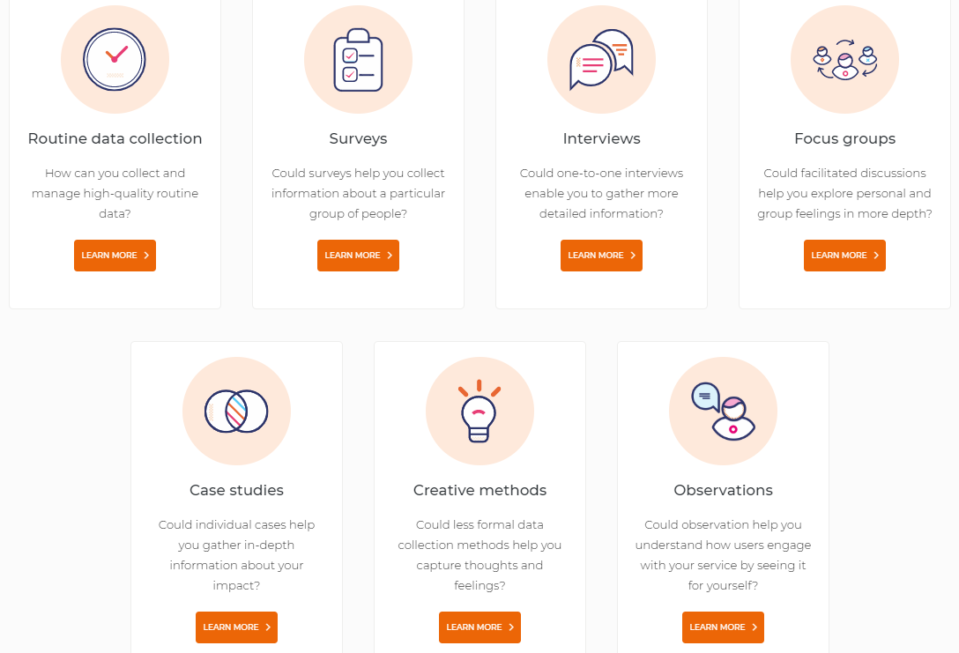
Data Collection and Research Methods
https://knowhow.ncvo.org.uk/organisation/impact/about-impact-and-evaluations
Notes:
That’s great – now let’s start thinking about methods. Now we’ve got our outcomes we need to think what methods of data collection are best to check our work is achieving these outcomes.
I’ll run through this just in case they aren’t too clear:
This is from NCVO, which gives a nice overview of the types of data collection that might avaliable to you.
Just to go through them: [I’m going to skip routine data cause that’s a really important one. ]
**Case studies are based on an in-depth investigation of a single individual, group or event** So this kind of depends on the type of work you do – but for example, if you’re hosting a series of workshops, focus one
Depth of information required
Think about how much information you need, and at what level of detail. If you need in-depth, qualitative data, interviews may be helpful. If not, you might choose a method that collects quantitative data such as a questionnaire.
Sensitivity and complexity of the issues
Do you need information on sensitive or complex issues such as people’s life style choices or behaviours? Consider which method will be appropriate for asking questions on these.
Time and skills required
How much time and skill are you and your staff able to allocate to designing and using data collection tools? focus groups need skilled facilitators. Also consider how much time you will be asking people taking part in your data collection to spend on this, and whether this is realistic and proportionate depending on the nature of contact you have had with them.
Ease of collection and analysis
Think about how straightforward it will be for you to collect and analyse data. Interviews and focus groups are likely to be more complex to record and analyse, but you may decide it’s important to spend time on this if you want to collect qualitative data.
Credibility
Will the methods you use be acceptable to the stakeholders you will be reporting to? If not, the information you collect may be questioned.
Some tools are well established. For example, interviews and questionnaires. Consider if these methods are appropriate.
If you decide to choose more unusual, visual or participatory tools, make sure those who will be using the evaluation agree that these ways of collecting information will provide sufficiently credible evidence.
Is the collection method appropriate to the service and its values?
It’s important to consider which tools are most appropriate to your organisation and its values.
In some situations, more informal methods or anecdotal data may be acceptable. In others you may need to use methods that are tried and tested, such as a validated questionnaire recognised and used in a particular field.
Reliability – can it be repeated: evaluation method that is repeated over a longer period of time.
A reliable method is one that can be applied consistently each time you use it, in different situations and with different people. It is essential when you are comparing information over time or between different participants and/or within different situations. If the question you ask can be interpreted differently by different people, your data may not be reliable.
It’s not necessarily a choice one method, but perhaps a combination of several methods.

Slide 11
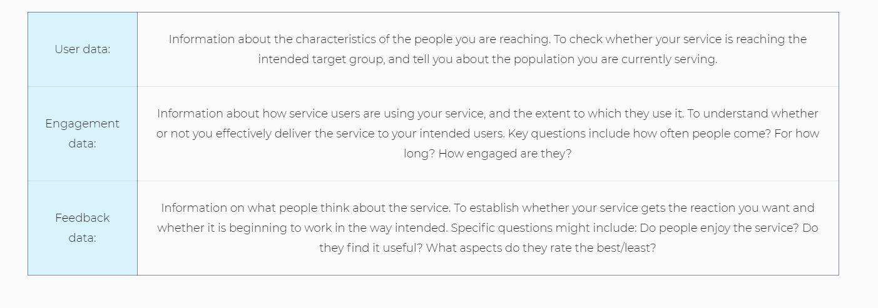
Routine Data
As a group, look at your outcomes and think about what might be the best method for data collection to contribute to your evaluation.
https://knowhow.ncvo.org.uk/organisation/impact/about-impact-and-evaluations
Notes:
Going back to routine data.
If you can do something with routine data collection do it and integrate it into your day to day work, then do it. It takes some effort to think about and embed but if you build it into your practice you’re set up with a pool of data that you can hopefully access as and when you need to.
As it says here, there are three main types of routine data:
User data**
Engagement data**
Feedback data**
As a group, look at your outcomes and think about what might be the best method of data collection to contribute to your evaluation. And then we’ll have a discussion about it.

